Slide 1
SQL Case Study - Danny's Diner
BY – Priyanka Sonar

Slide 2
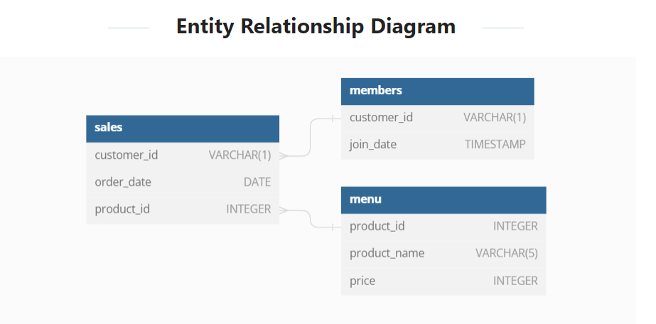

Slide 3
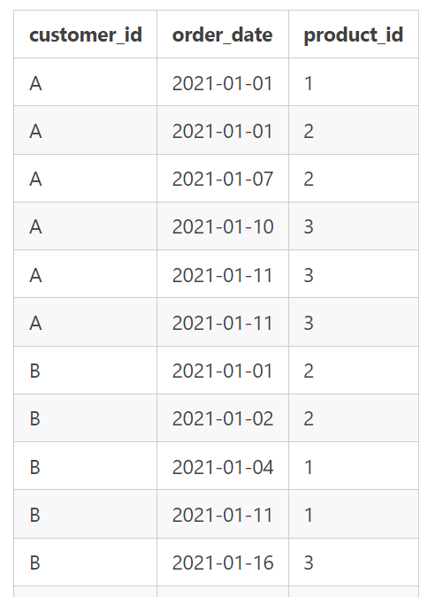
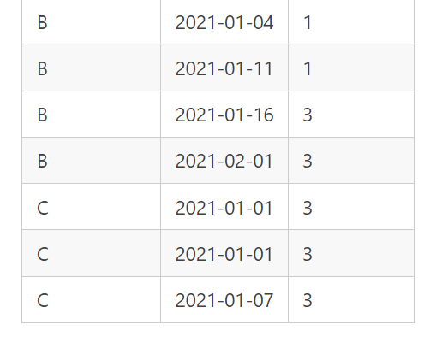
Table 1 - Sales
The sales table captures all customer_id level purchases with an corresponding
order_date and product_id information for when and what menu items were ordered.

Slide 4
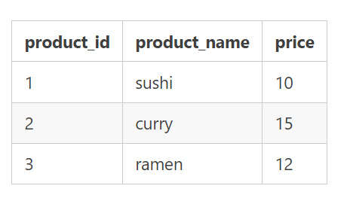
Table 2 - Menu
The menu table maps the product_id to the actual product_name
and price of each menu item.

Slide 5
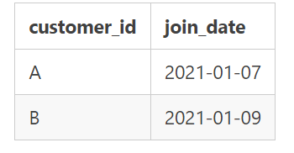
Table 3 - Members
The final members table captures the join_date when a
customer_id joined the beta version of the Danny’s Diner loyalty program.

Slide 6

1) What is the total amount each customer spent at the restaurant?
select a.customer_id,sum(b.price) as totalspent
from sales a
join menu b
on a.product_id=b.product_id
group by a.customer_id

Slide 7

2) How many days has each customer visited the restaurant?
select customer_id,count(distinct order_date) as numberofdays
from sales
group by customer_id

Slide 8
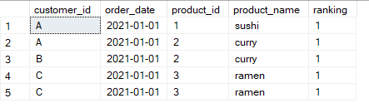
3) What was the first item from the menu purchased by each customer?
with final as (
select a.*,b.product_name,
rank() over (partition by customer_id order by order_date) as ranking
from sales a
join menu b
on a.product_id=b.product_id)
select * from final where ranking=1

Slide 9
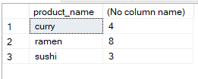
Q4) What is the most purchased item on the menu and how many times was it purchased by all customers?
select b.product_name,count(*)
from sales a
join menu b
on a.product_id=b.product_id
group by b.product_name

Slide 10
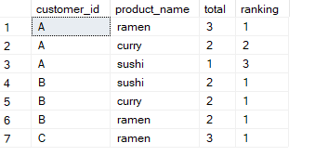
Q5) Which item was the most popular for each customer?
with final as(
select a.customer_id,b.product_name,count(*) as total
from sales a
join menu b
on a.product_id=b.product_id
group by a.customer_id,b.product_name)
select customer_id,product_name,total,
rank() over (partition by customer_id order by total desc) as ranking
from final

Slide 11

Q6) Which item was purchased first by the customer after they became a member?
with final as (
select a.*,b.customer_id as customerid,b.join_date,
rank() over (partition by a.customer_id order by order_date) as ranking,
c.product_name
from sales a
left join members b
on a.customer_id=b.customer_id
join menu c
on a.product_id=c.product_id
where a.order_date>=b.join_date
)
select customer_id,ranking,product_name from final where ranking=1

Slide 12

Q7) Which item was purchased just before the customer became a member?
select a.customer_id,count(a.product_id) as items,sum(c.price) as totalspent
from sales a
left join members b
on a.customer_id=b.customer_id
join menu c
on a.product_id=c.product_id
where a.order_date<b.join_date
group by a.customer_id

Slide 13

Q8) What is the total items and amount spent for each member before they became a member?
with memberdata as (
select a.customer_id,a.order_date,b.join_date,c.price,c.product_name
from sales a
left join members b
on a.customer_id=b.customer_id
join menu c
on a.product_id=c.product_id
where a.order_date<b.join_date)
select customer_id,sum(price),count(distinct product_name)
from memberdata
group by customer_id

Slide 14
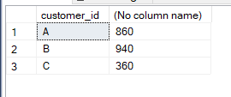
Q9) If each $1 spent equates to 10 points and sushi has a 2x points multiplier - how many points would each customer have?
with points as (
select a.customer_id,a.order_date,c.product_name,c.price,
case when product_name='sushi' then 2*c.price
else c.price end as newprice
from sales a
join menu c
on a.product_id=c.product_id
)
select customer_id,sum(newprice)*10 from points
group by customer_id

Slide 15

Q10) In the first week after a customer joins the program (including their join date) they earn 2x points on all items, not just sushi - how many points do customer A and B have at the end of January?
WITH finalpoints AS (
SELECT a.customer_id,
a.order_date,
c.product_name,
c.price,
CASE WHEN product_name = 'sushi' THEN 2 * c.price
WHEN a.order_date BETWEEN b.join_date AND DATEADD(day, 6, b.join_date) THEN 2 * c.price
ELSE c.price
END AS newprice
FROM sales a
JOIN menu c ON a.product_id = c.product_id
JOIN members b ON a.customer_id = b.customer_id
WHERE a.order_date <= '2021-01-31'
)
SELECT customer_id, SUM(newprice) * 10 AS total_amount
FROM finalpoints
GROUP BY customer_id;

